Slide 1

de Broglie
Wavelength

Slide 2
Key Objectives
On the atomic level, energy and matter exhibit the characteristics of both waves and particles. Young’s double slit experiment is explained with a wave model but produces the same interference and diffraction patterns when one photon at a time or one electron at a time are passed through the slits

Slide 3

Relevant Equations
$$de broglie λ=\frac{h}{p}$$

Slide 4
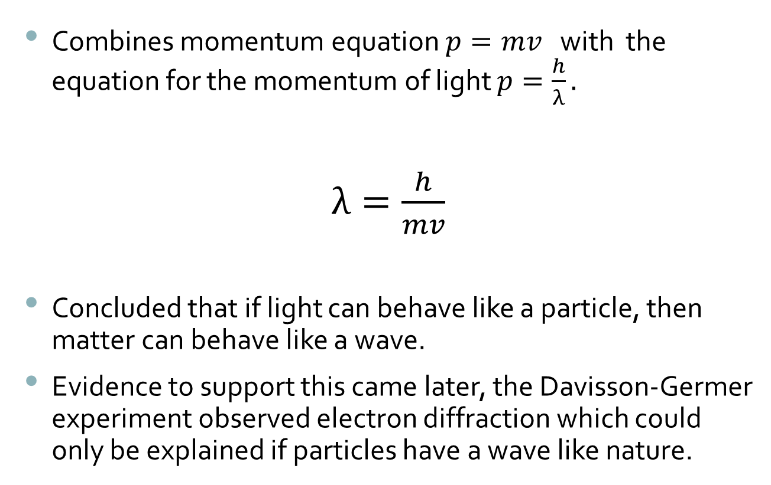
de Broglie wavelength
Combines momentum equation $p=mv$ with the equation for the momentum of light $p=\frac{h}{λ}.$
$λ=\frac{h}{mv}$
Concluded that if light can behave like a particle, then matter can behave like a wave.
Evidence to support this came later, the Davisson-Germer experiment observed electron diffraction which could only be explained if particles have a wave like nature.

Slide 5
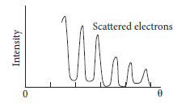
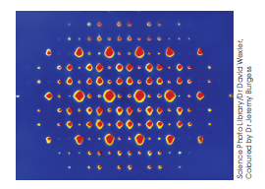
Electron diffraction
In simple terms: When electrons reflect from a crystal, a diffraction pattern characteristic of wave interference is observed.

Slide 6
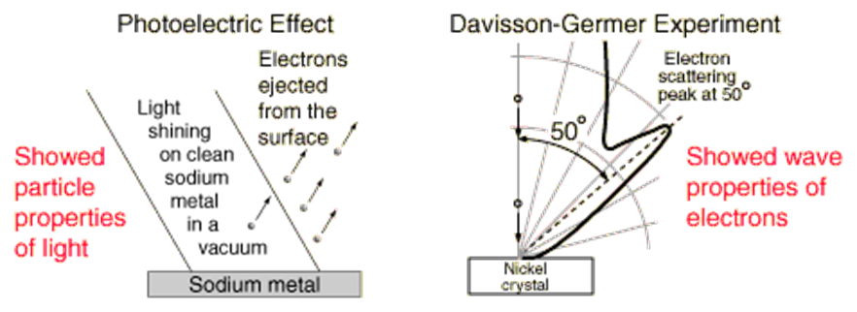
Davisson-Germer Experiment
An electron beam was directed at a target which was a defined crystal structure made of nickel. The nickel could be rotated to observe angular dependence of the scattered electrons. The electrons could reflect off from different layers.
Their electron detector was mounted on an arc so that it could be rotated to detect the intensity of the reflected electrons at different angles.
The reflected electrons constructively and destructively interfered with each (a property of waves…)

Slide 7
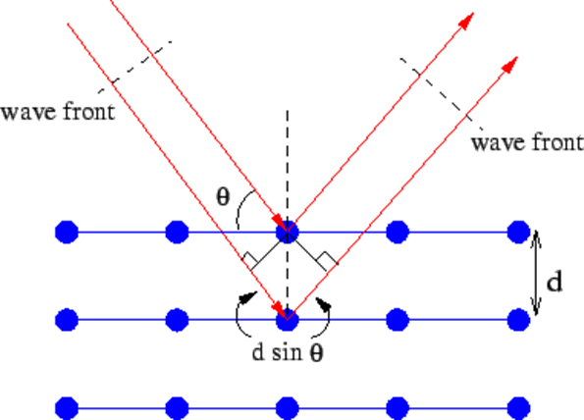
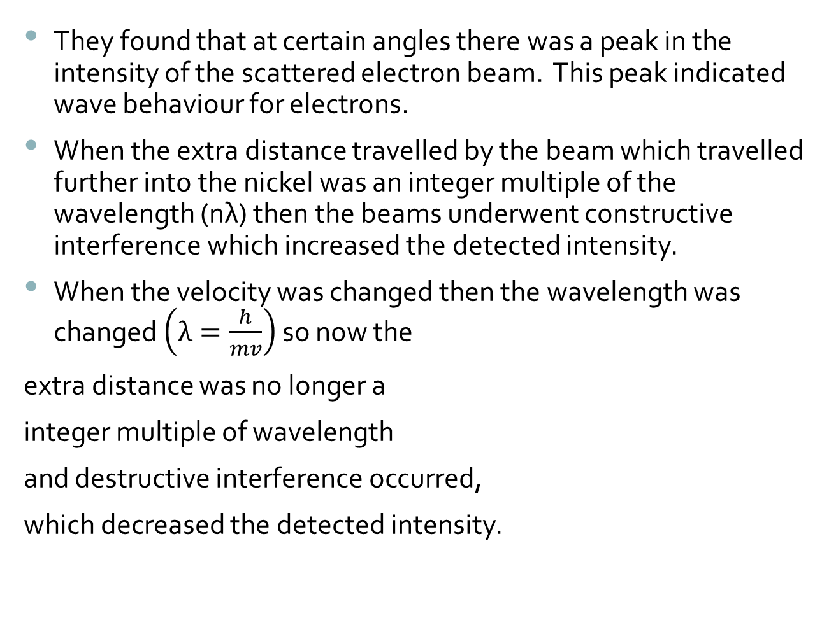
They found that at certain angles there was a peak in the intensity of the scattered electron beam. This peak indicated wave behaviour for electrons.
When the extra distance travelled by the beam which travelled further into the nickel was an integer multiple of the wavelength (nλ) then the beams underwent constructive interference which increased the detected intensity.
When the velocity was changed then the wavelength was changed $\left(λ=\frac{h}{mv}\right)$ so now the
extra distance was no longer a
integer multiple of wavelength
and destructive interference occurred,
which decreased the detected intensity.

Slide 8
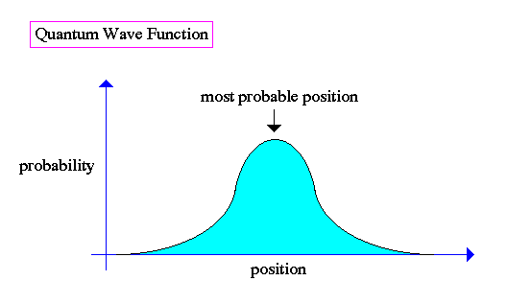
Particles as a wave
Our understanding of particles is they have a defined location at a defined time.
If particles have a wave nature then that means that particles do not have a defined location at a defined time.
Instead particles have a probability distribution of where they could be.

Slide 9
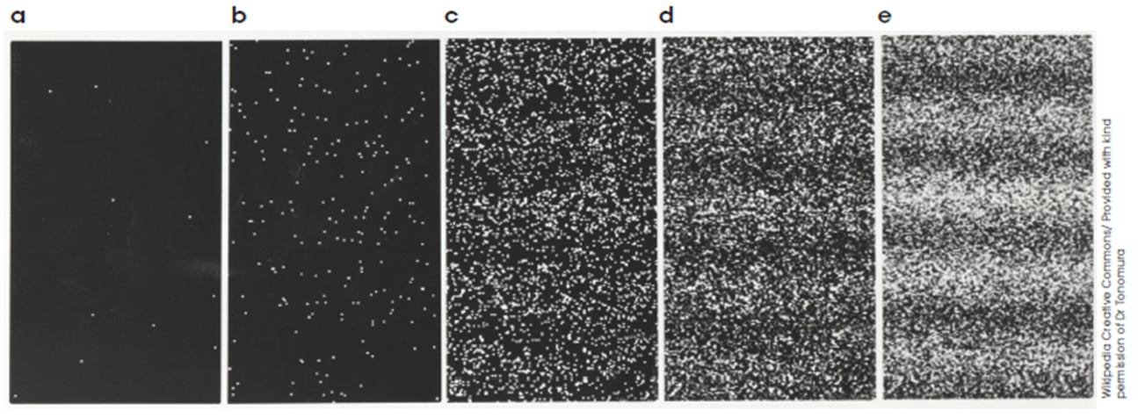
Electron interference patterns build up in terms of probability distribution.
There is a finite probability of the electron appearing at each point on the screen.
After many single events the pattern emerges.
What is interfering is the probability wave.

Slide 10
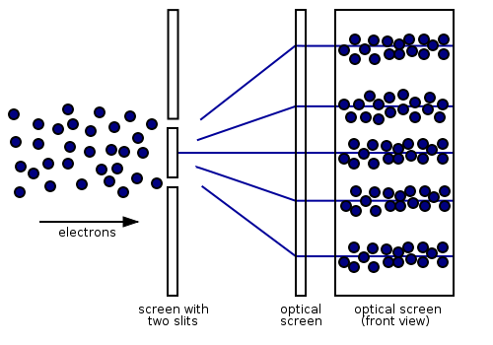
Young’s double slit experiment with electrons
In this version we replace the photons with electrons. The resulting pattern on the viewing screen is the same as observed with photons – a pattern of high intensity regions and low intensity regions.
Diffraction and interference occurs.
This pattern can only be explained if the electrons have a wave like nature
Notes:
If you block one of the slits you observe a diffraction pattern.
If you do this experiment firing one electron at a time then you still get the interference pattern, this is due to the probability wave, the fired electron has a probability wave in the vertical position as well. The electron passes through both slits at the same time according to quantum physics (the electron can be in all possible states at one time, until observed, once it has been observed you have a set location – once observed it acts like a particle and not a wave).

Slide 11

Question: What is the wavelength of an electron moving at a velocity of $3.00×{10}^{5}m s^{−1}$?
Answer: $λ=\frac{h}{mv}=\frac{6.63×{10}^{−34}}{9.11×{10}^{−31}\left(3.00×{10}^{5}\right)}=2.43×{10}^{−9}m$
Note: The size of the wavelength for the electron is much greater than the size of the electron. For everyday particles (like a basketball moving at a given velocity) the wavelength is smaller than the size of the object. This is why we do not see wave properties in everyday objects.

Slide 12
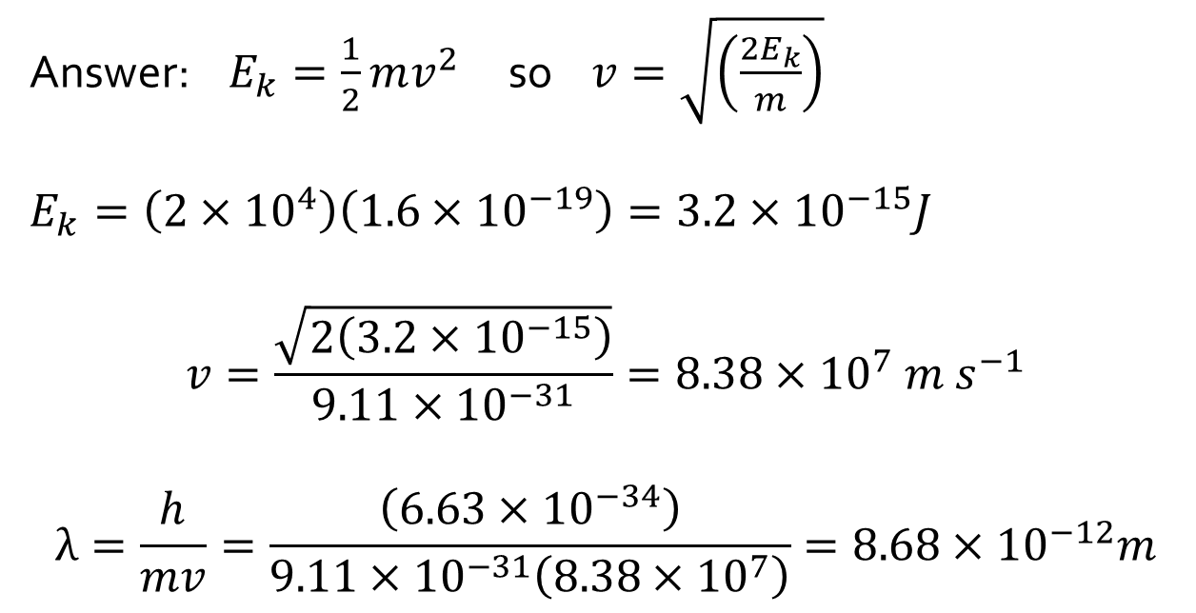
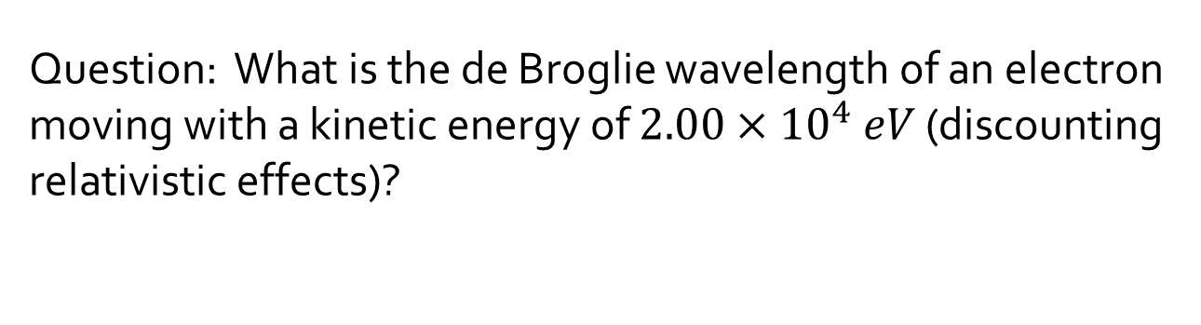
Question: What is the de Broglie wavelength of an electron moving with a kinetic energy of $2.00×{10}^{4} eV$ (discounting relativistic effects)?
Answer: $E_{k}=\frac{1}{2}mv^{2}$ so $v=\sqrt{\left(\frac{2E_{k}}{m}\right)}$
$E_{k}=\left(2×{10}^{4}\right)\left(1.6×{10}^{−19}\right)=3.2×{10}^{−15}J$
$$v=\frac{\sqrt{2\left(3.2×{10}^{−15}\right)}}{9.11×{10}^{−31}}=8.38×{10}^{7} m s^{−1}$$
$$λ=\frac{h}{mv}=\frac{\left(6.63×{10}^{−34}\right)}{9.11×{10}^{−31}\left(8.38×{10}^{7}\right)}=8.68×{10}^{−12}m$$

Slide 13

Question: What is the de Broglie wavelength of a bullet of mass 12.4 g moving at $2.51 ×{10}^{2} m s^{−1}$?
Answer: $λ=\frac{h}{mv}=\frac{6.63×{10}^{−34}}{\left(12.4×{10}^{−3}\right)\left(2.51×{10}^{2}\right)}=2.13×{10}^{−34} m$

